Slide 1


Systems Testing and Quality Management Assignment 3
Group 1
Zhuohang Li Xiaoyuanying Kuang Chang Liu
Zihao Yu Haojiang Shi Qirui Zhao

Slide 2

Content
01
System Test Plan (STP)
02
Main Functions
03
Test Case
04
Gantt chart
05
Detailed Defect
06
Test Summary& recommedation

Slide 3

01
System Test Plan (STP)

Slide 4





System Test Plan
Purpose:
The STP outlines the approach and management for system testing, aiming to ensure a system meets its requirements by assessing its overall behavior.
Know what we do
Conclusion
Prepare our work
Chart
2
4
1
3
5
test
Start
Find bug
summary
learn

Slide 5
02
Main Functions

Slide 6
Brief description of the function | Importance (L, M, H) | Test case label | Include/Exclude in system test
Sign up for UTS Fine Dining | H | TC_SignUp | include
Login account | H | TC_Login | include
Reset the password after forgetting it | L | TC_ResetPassword | include
Browse food through the menu function | M | TC_BrowseMenu | include
Fill in the reservation information | H | TC_FillReservationInfo | include
Modify reservation | H | TC_ModifyReservation | include
cancel reservation | H | TC_CancelReservation | include
Contact official personnel through three methods | L | TC_ContactPersonnel | include
Using admin tools to manage severs | H | TC_AdminServerManagement | include

Slide 7
03
Test Case

Slide 8
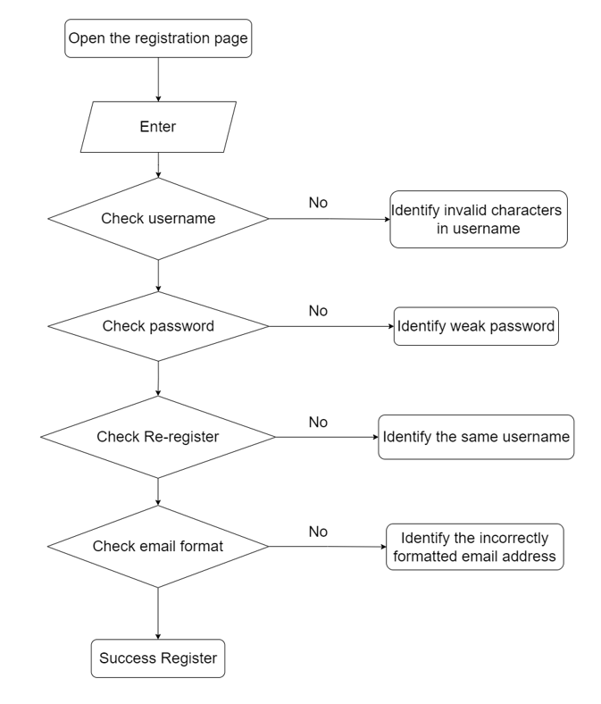
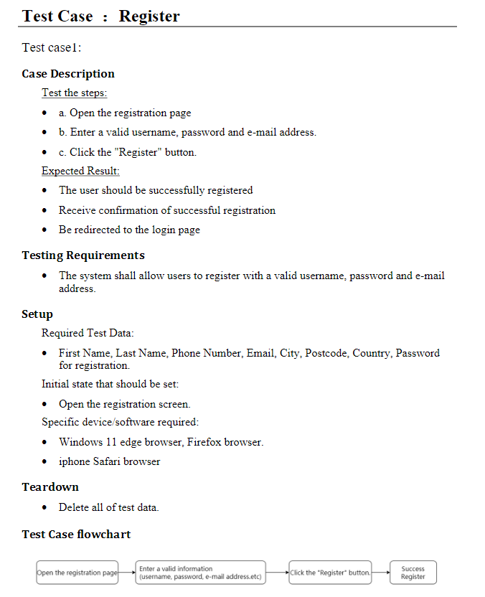
Test Case ：Register
Test case1

Slide 9
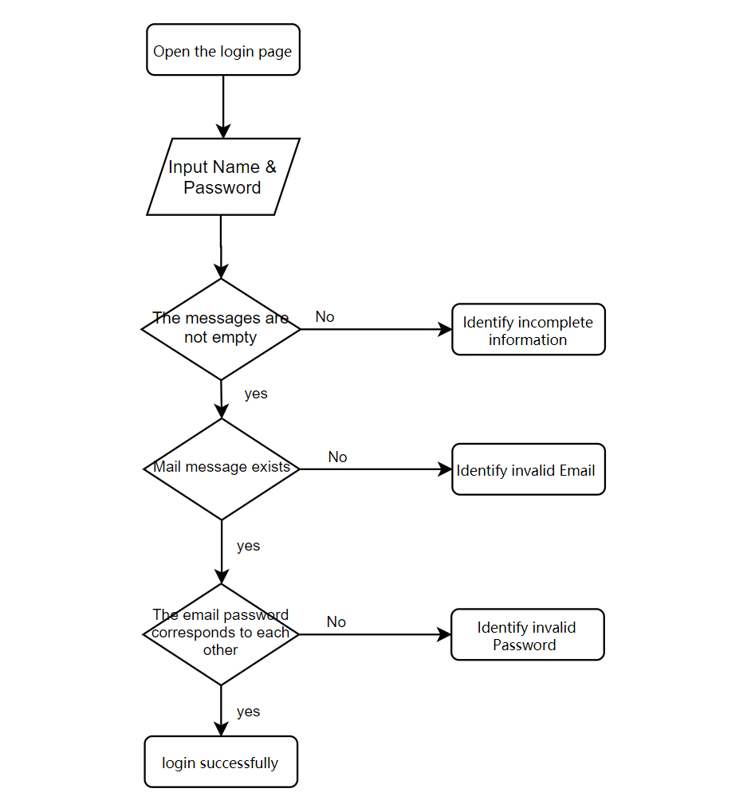
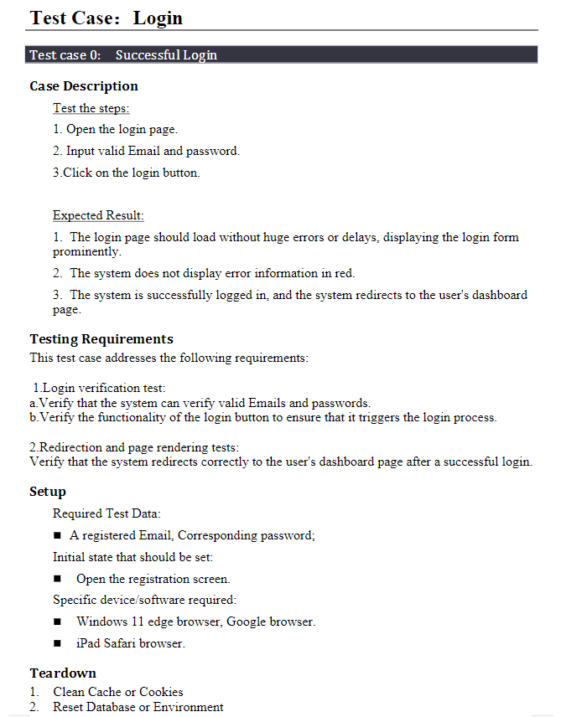
Test Case ：Login
Test case2

Slide 10
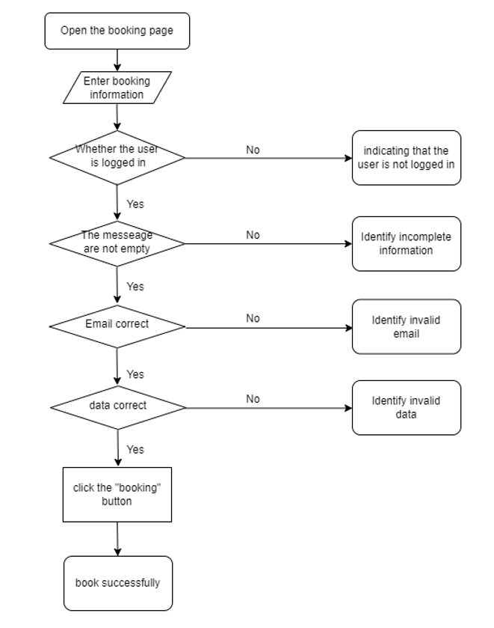
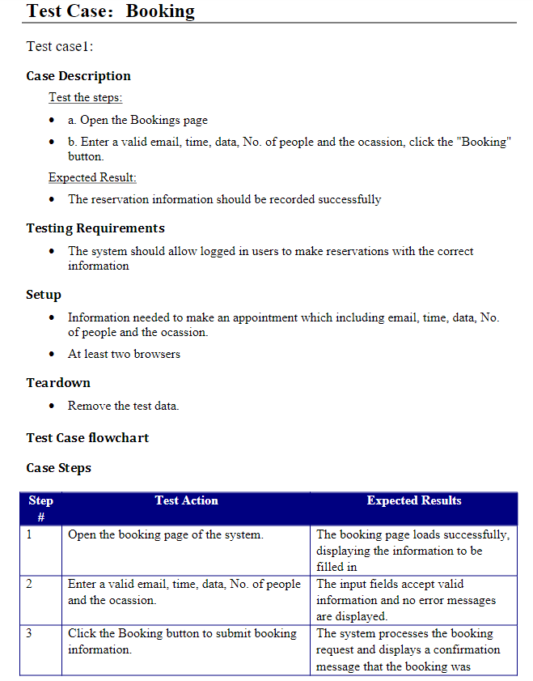
Test Case ：Booking
Test case3

Slide 11
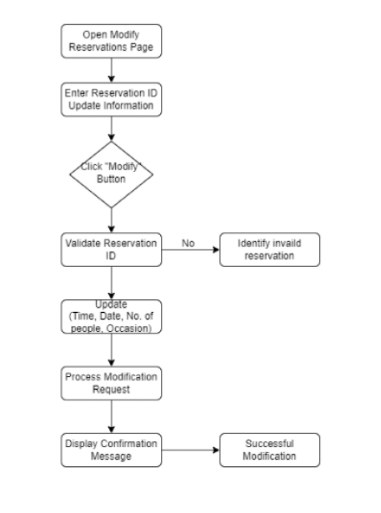
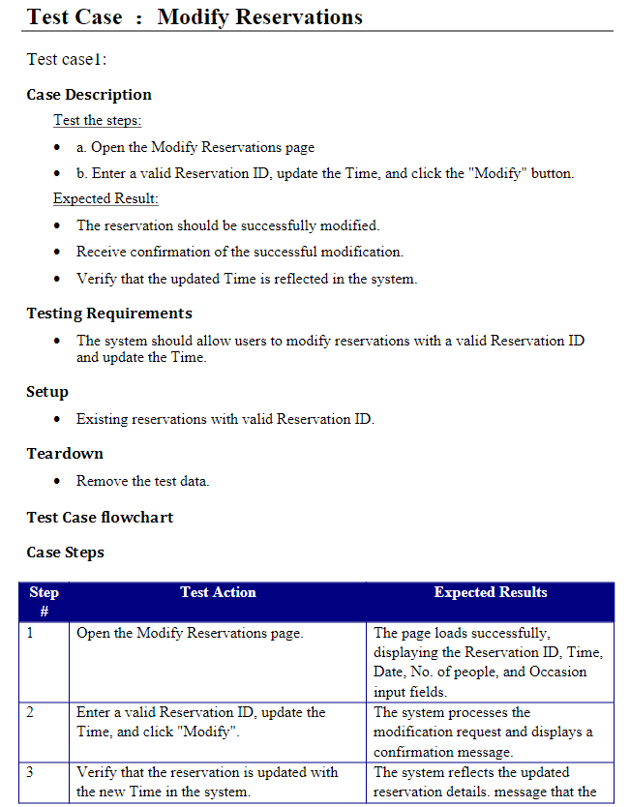
Test Case ：Modify reservation
Test case4

Slide 12
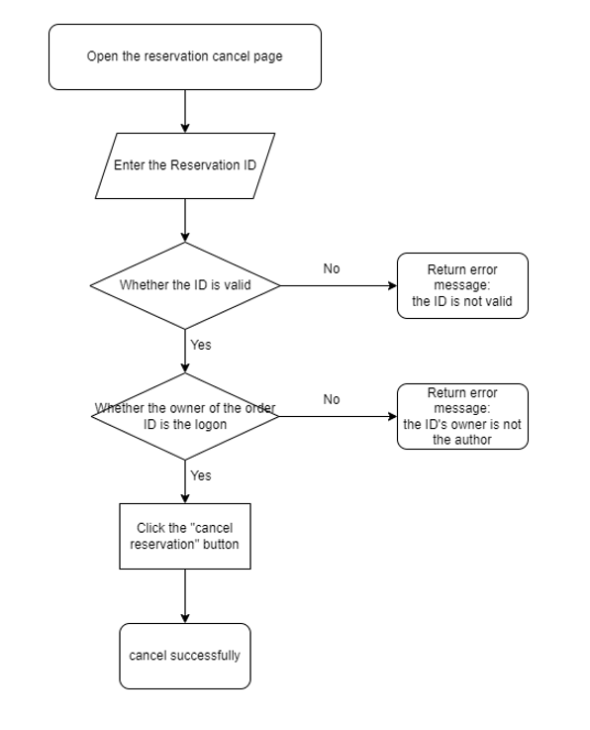
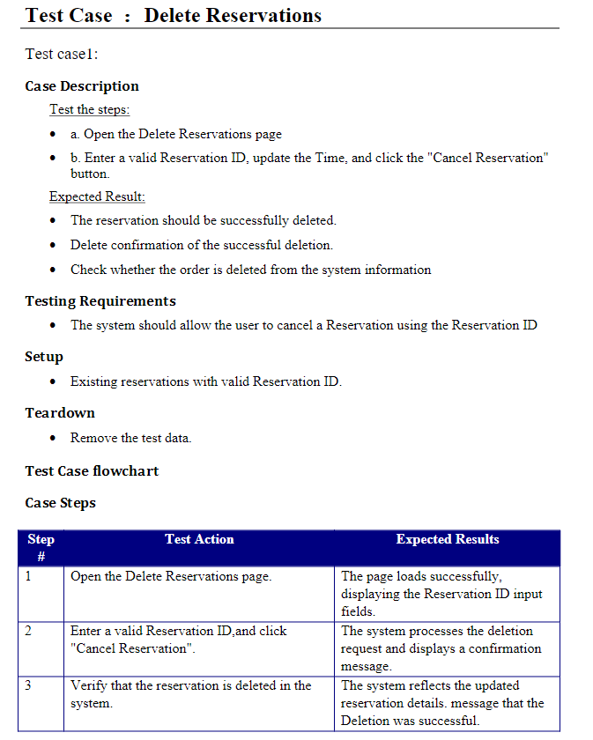
Test Case ：Delete reservation
Test case5

Slide 13
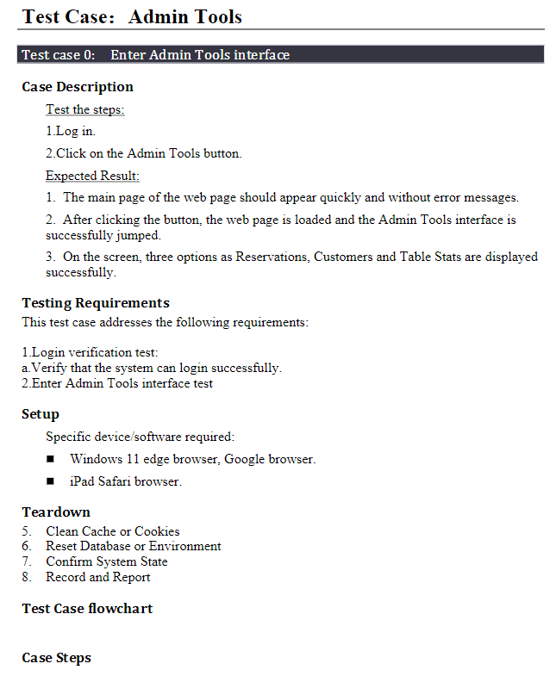
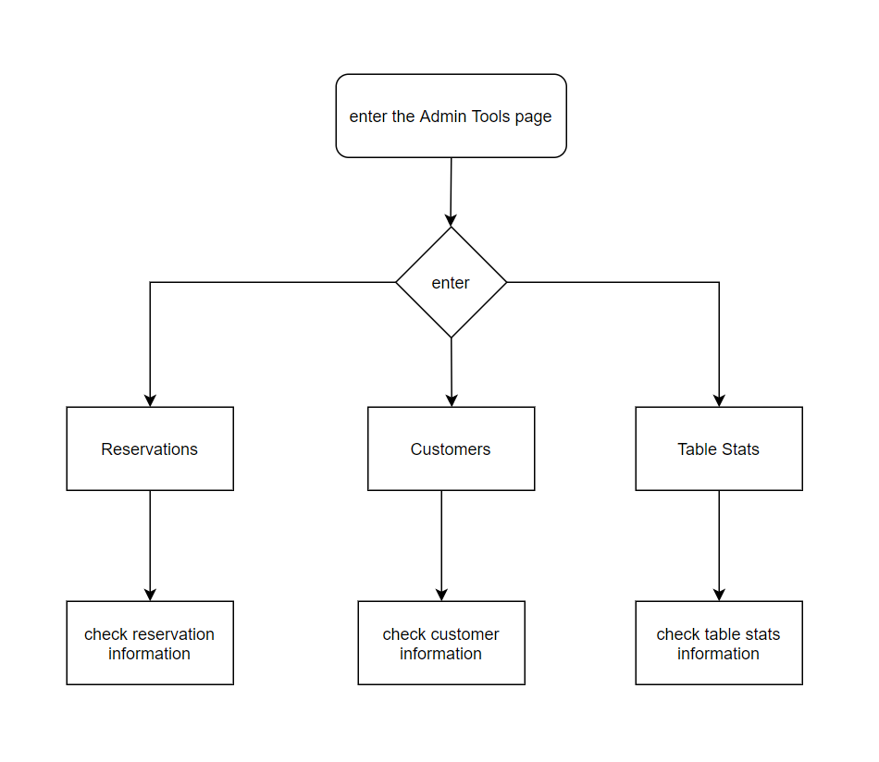
Test Case ：Admin tools
Test case6

Slide 14
04
Gantt chart

Slide 15
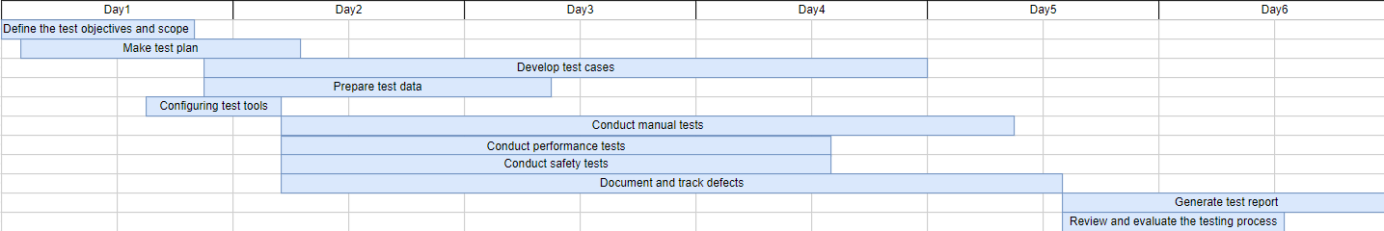
Our schedule
Preparation
Test report and evaluation
Test Planning
Case Testing

Slide 16
05
Detailed Defect

Slide 17
Detailed Defect:
Defect ID | Component | Summary of defect | Severity
D1000 | Register | No error typeis displayed when an error occurs during registration. | Critical
D1001 | Register | The email format and authenticitywere not checked at the time of registration. | Major
D1002 | Register | The registration interface Terms & Privacypoints to aninvalid link. | Cosmetic
D1003 | Login | The Forgot password linkto the login screen isinvalid. | Critical
D1004 | Booking | The Display Statusof the Table Layout interface points to aninvalidlink. | Minor
D1005 | Booking | Booking without selecting a datewill still be successful. | Medium
D1006 | Booking | Note The reservation information can be modifiedeven if a number ofparametersare not specified. | Medium
D1007 | Booking | Some product pictureson the product interface cannot bedisplayedcorrectly. | Minor
D1008 | Admin tools | Admin tools exposes all user information to non-administrator interfaces. | Critical
D1009 | Interface | Booking options are not shown in the left sidebar and can only be opened by clicking on the Bookings at the top. | Coesmetic

Slide 18
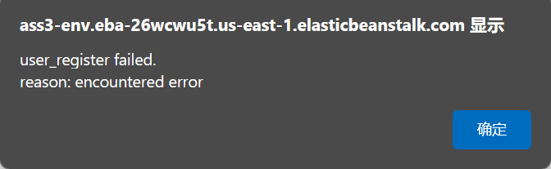
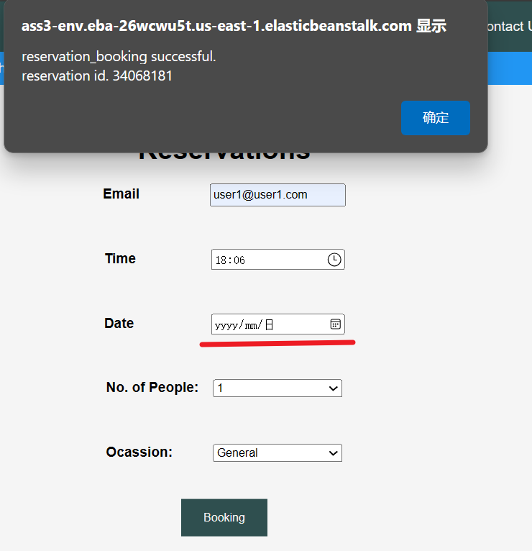
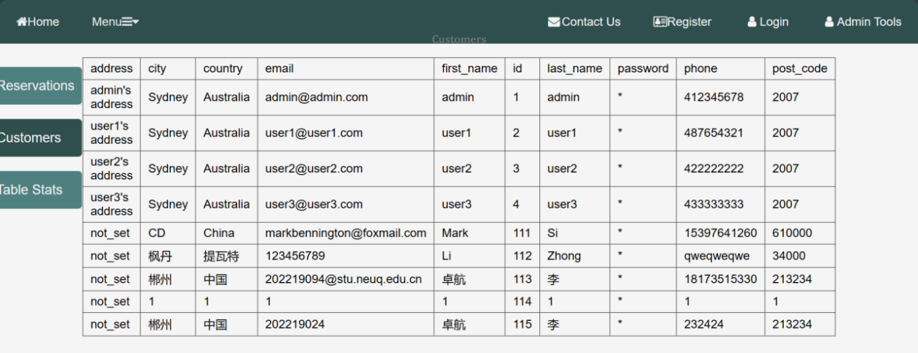
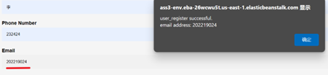
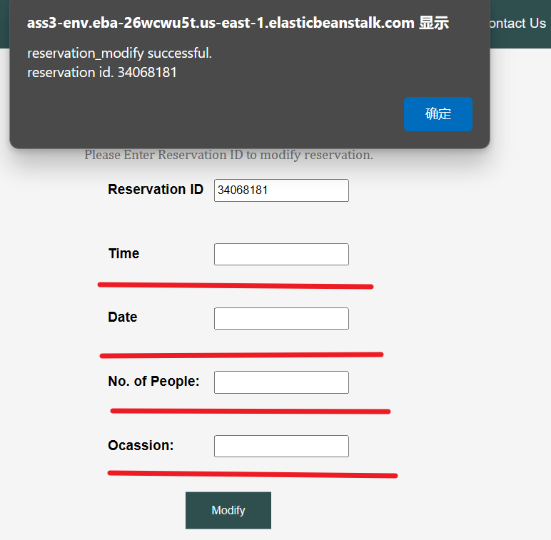
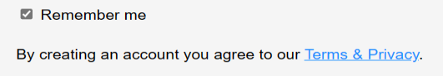
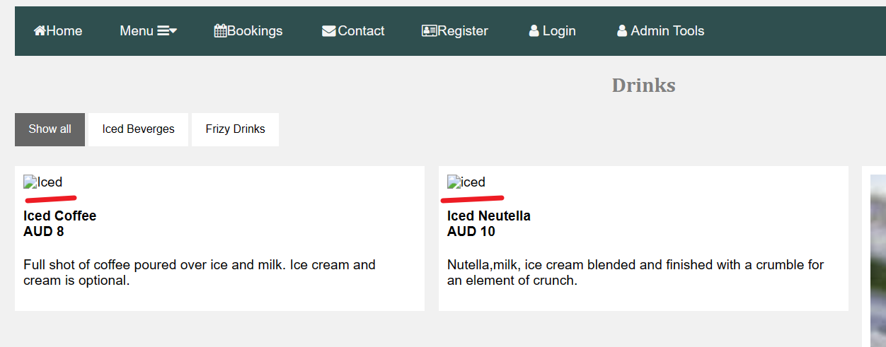
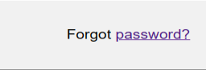
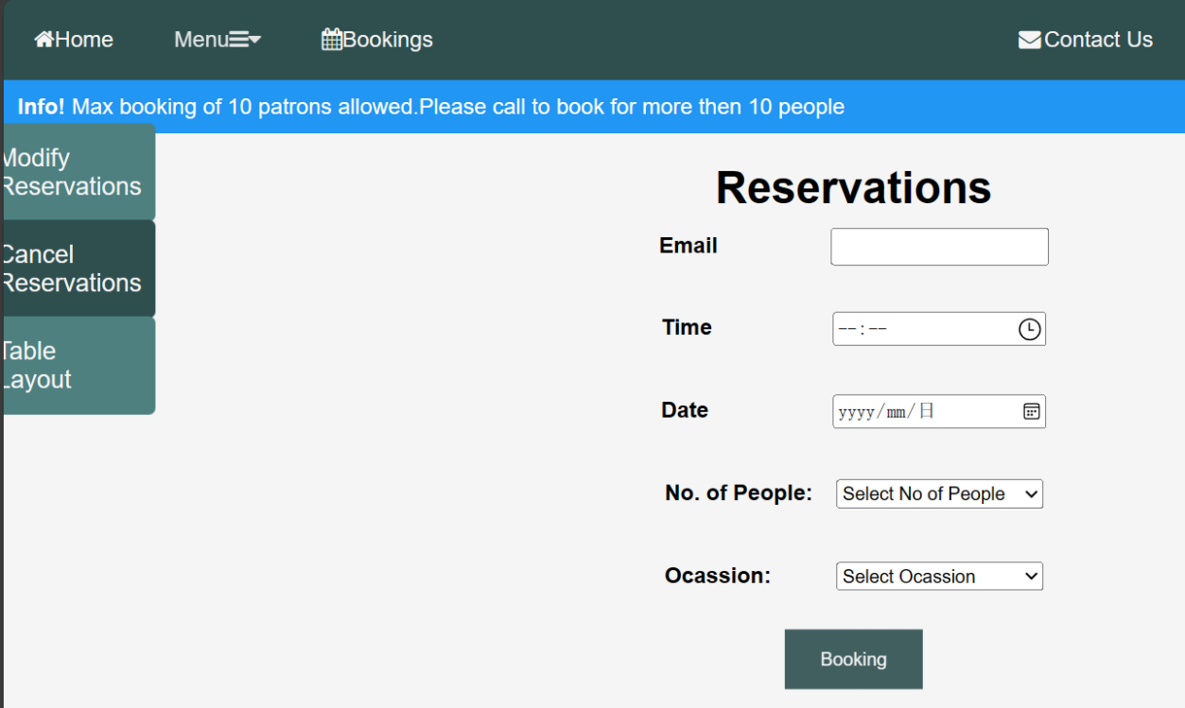
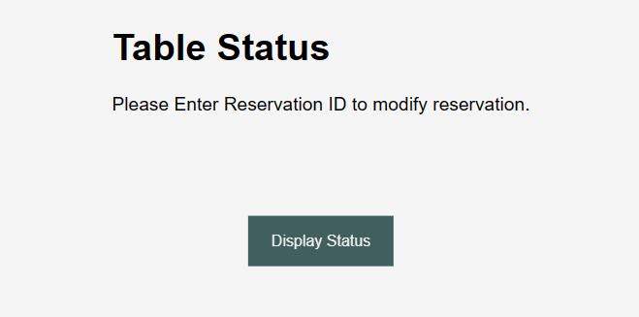
Detailed Defect:

Slide 19
06
Test Summary& Recommedation

Slide 20
Learnings and Observations:
Test Planning and Strategy:
– Planning ahead
Test Case Design:
– Functional full coverage
Defect Reporting:
– “precise and comprehensive”
– “swiftly resolving bugs”
User Experience Testing:
– Ensuring seamless user interaction
Recommedation
No.
Key considerations | Expression
Test Results and Goal Achievement | Fall short of expectations
Issue and Defect Resolution | Defects affect whether the next phase of the migration is smooth
Risk Assessment | High
Stakeholder Input | Disappointing
Summary

Slide 21
THANK YOU
Group 1
Zhuohang Li Xiaoyuanying Kuang Chang Liu
Zihao Yu Haojiang Shi Qirui Zhao

